Slide 1


Library Management System
Presentated by GROUP 25 (

Slide 2

PROJECT INTRODUCTION

Slide 3






Slide 4


The problems public libraries have told to us are,
Documented information is difficult to update.
Difficult to maintain.
Searching for books takes time.
Information may be destroyed.

Slide 5

Project Introduction
Purpose
Intended Audience
Scope

Slide 6

Overall Description
Product Perspective
User Characteristics (User Capabilities)
Product Functions

Slide 7

SYSTEM FEATURES AND REQUIREMENTS
Functional Requirements
Non-Functional Requirements
User authentication
Student registration
Book cataloguing and management
Order placement and management
Notification of last date for delivery of books
Communication functions
Performance
Security
Reliability
Usability

Slide 8

SYSTEM DESIGN
Product Features
User Authentication and Authorization
Student Registration
Book Catalog Management
Order Placement and Management
Notification System
Communication Tools

Slide 9

SYSTEM DESIGN
Product Environment
Symbols
Relationships
ER-Diagram
Entities
Use cases
Database Tables

Slide 10
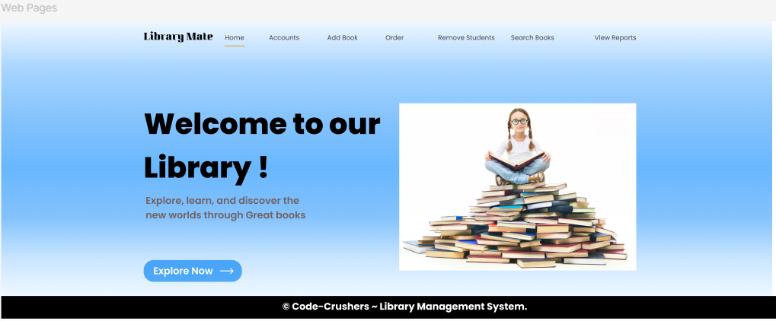

Here are our ui/ux design
Figma link -https://www.figma.com/design/YSH4E2ZKTvjfYbXPoLjc6G/Library-management-System.?node-id=0-1

Slide 11
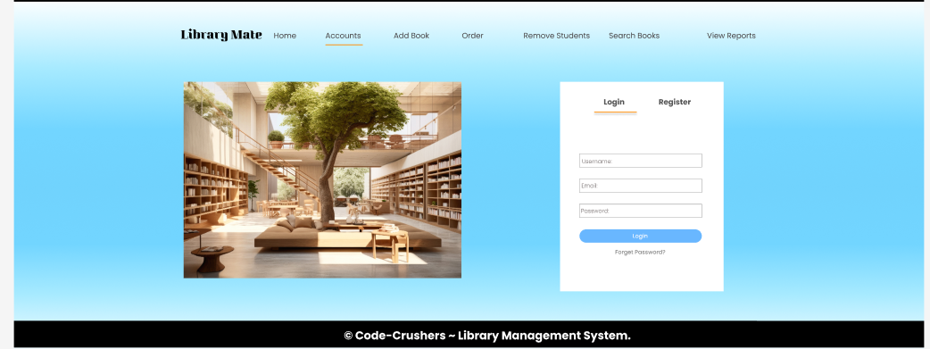

Here are our ui/ux design
Figma link -https://www.figma.com/design/YSH4E2ZKTvjfYbXPoLjc6G/Library-management-System.?node-id=0-1

Slide 12
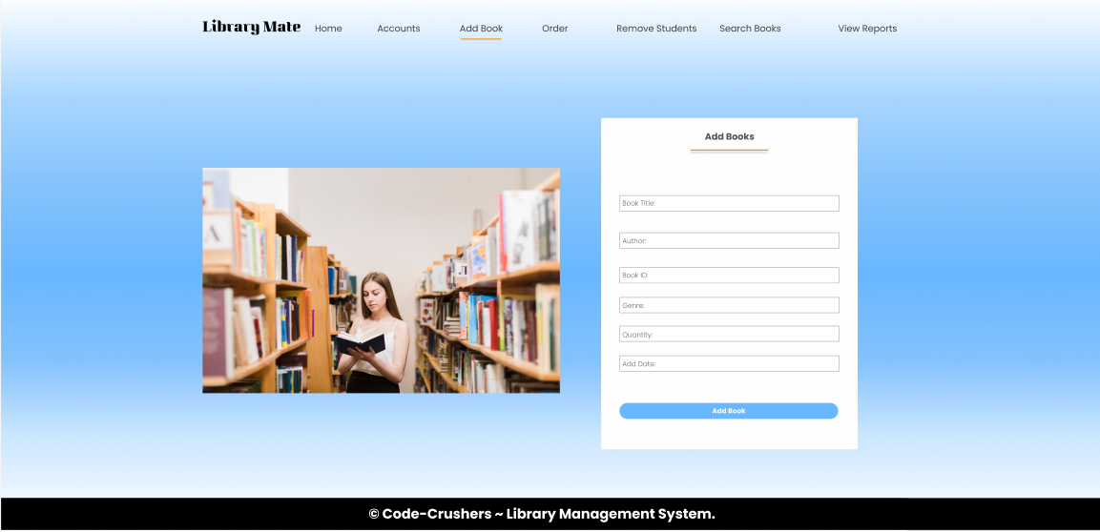
Here are our ui/ux design
Figma link -https://www.figma.com/design/YSH4E2ZKTvjfYbXPoLjc6G/Library-management-System.?node-id=0-1

Slide 13
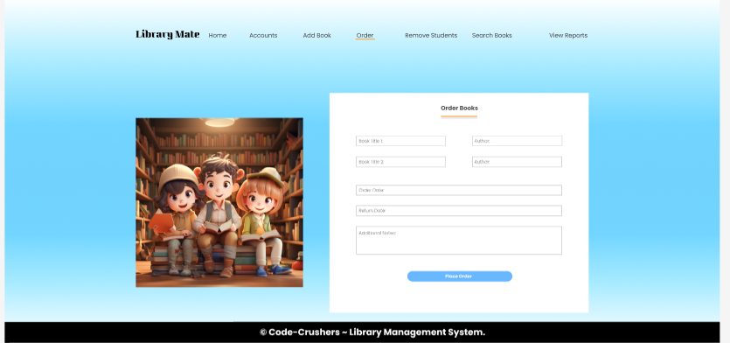
Here are our ui/ux design
Figma link -https://www.figma.com/design/YSH4E2ZKTvjfYbXPoLjc6G/Library-management-System.?node-id=0-1

Slide 14
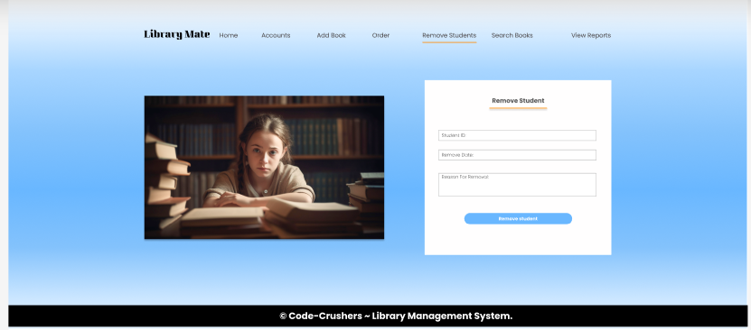
Here are our ui/ux design
Figma link -https://www.figma.com/design/YSH4E2ZKTvjfYbXPoLjc6G/Library-management-System.?node-id=0-1

Slide 15
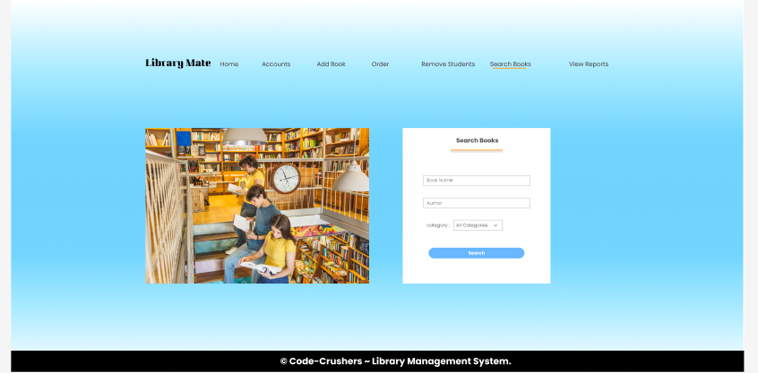
Here are our ui/ux design
Figma link -https://www.figma.com/design/YSH4E2ZKTvjfYbXPoLjc6G/Library-management-System.?node-id=0-1

Slide 16
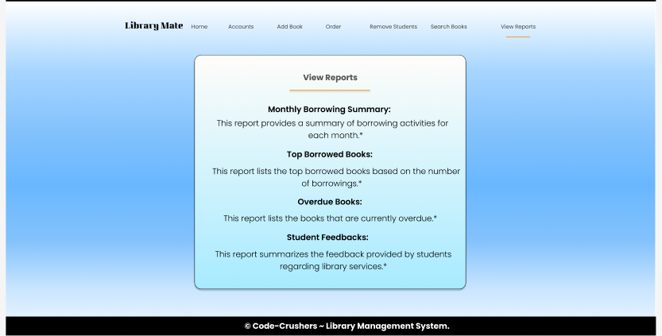
Here are our ui/ux design
Figma link -https://www.figma.com/design/YSH4E2ZKTvjfYbXPoLjc6G/Library-management-System.?node-id=0-1

Slide 17


Here are our GitHub link
https://github.com/Hirucodes/LibraryMate

Slide 18
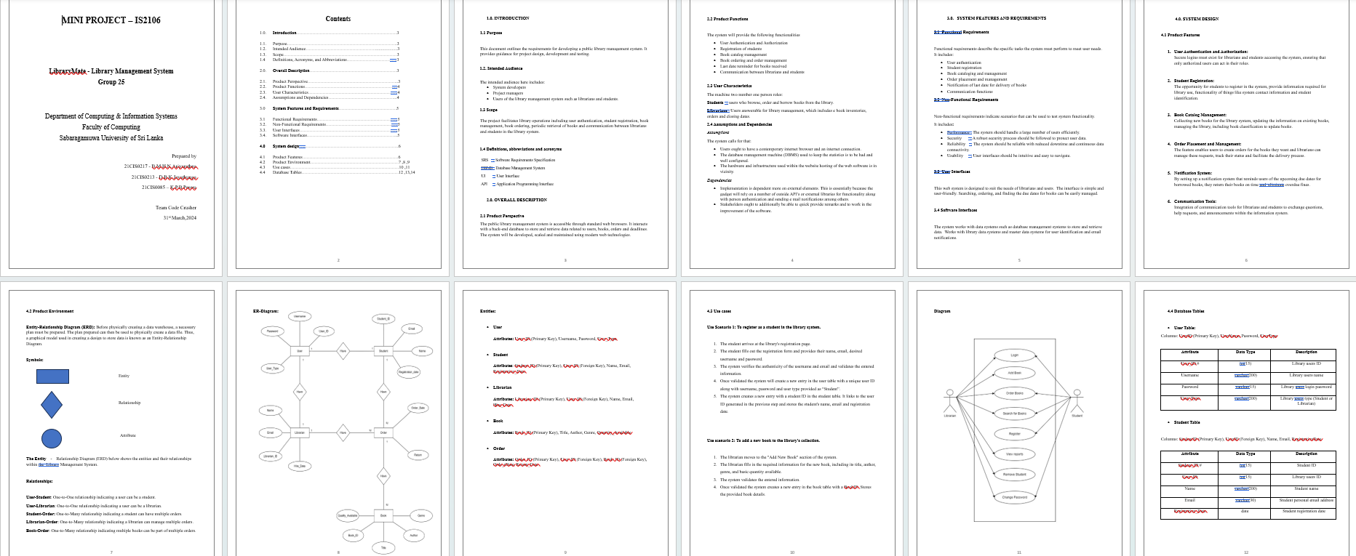
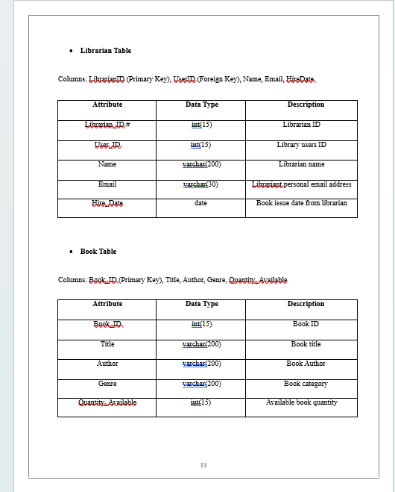
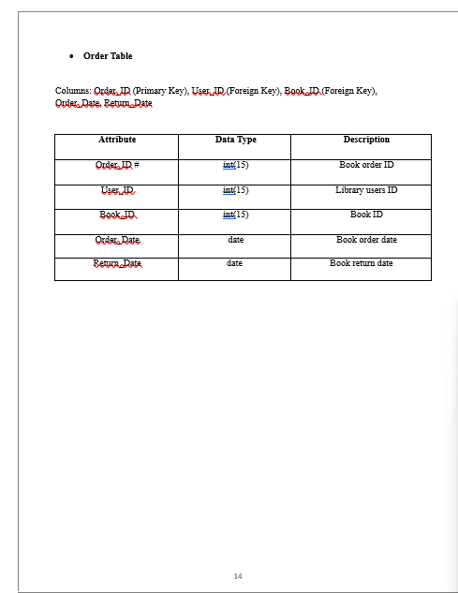
Here are our SRS Documents
https://github.com/Hirucodes/LibraryMate

Slide 19




GitHub
Softwares that we are using when developing the Library-Mate
HTML, CSS, JS
Figma
MySql
Java

Slide 20
What is the current status of the
Library-Mate?
Finished developing the front end.
Faced some problems during developing the front end.
Took solutions to solve these problems.
Next have to develop the back end.

Slide 21

Conclusion
Library-Mate aims to make managing libraries easier by solving common problems. We've finished building the front part of the system and are now working on the back part. We're using various tools and technologies to create a simple and efficient library management solution.

Slide 22



Our Team
21CIS0217
21CIS0213
21CIS0085
BMHN Ariyarathna
DBK Jayathunga
KPB Perera

Slide 23
THANK
YOU

